Slide 1
Lecture
Incremental Analysis & Pricing
9
L.O. 20-1: Decision-making and incremental analysis
L.O. 20-2: Special orders
L.O. 20-3: Make or buy
L.O. 20-4: Sell or process further
L.O. 20-6: Eliminate unprofitable segment or product
L.O. 21-1: Target costing
L.O. 21-2: Cost-plus and variable-cost pricing

Slide 2
Learning Objective 20-1
Decision-Making and
Incremental Analysis

Slide 3
Outline
The incremental analysis approach
Key concepts in incremental analysis
Types of incremental analysis

Slide 4
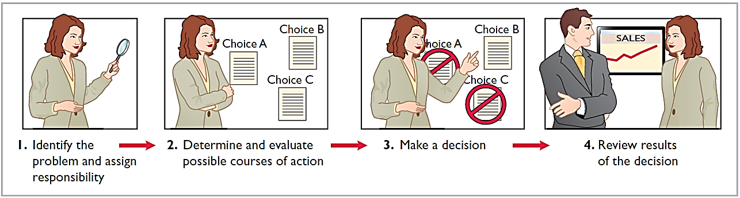
Decision-Making Process
Making decisions is an important management function.
Does not always follow a set pattern.
Decisions vary in scope, urgency, and importance.
Steps usually involved in process include:

Slide 5
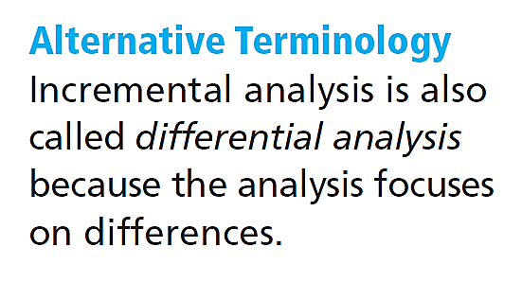
Incremental Analysis Approach
Decisions involve a choice among alternative actions.
Incremental analysis is process used to identify the financial data that change under alternative courses of action.
Both costs and revenues may vary
Only revenues may vary
Only costs may vary

Slide 6
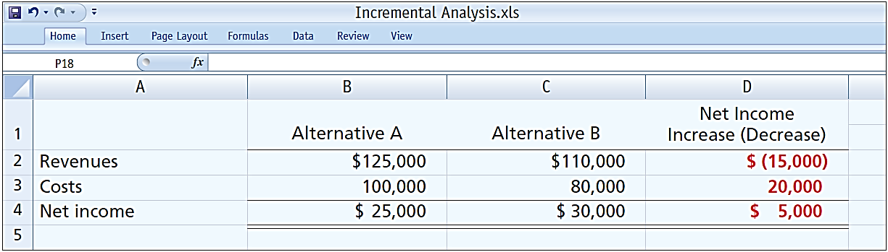
How Incremental Analysis Works
Incremental revenue is $15,000 less under Alternative B.
Incremental cost savings of $20,000 is realized.
Alternative B produces $5,000 more net income.

Slide 7
Key Concepts
Important concepts used in incremental analysis:
Relevant costs and revenues – costs and revenues that differ across alternatives.
Opportunity costs – lost benefits from choosing one course of action over the other.
Sunk costs – incurred costs that will not be changed or avoided by any present or future decisions.

Slide 8
Types of Incremental Analysis
Common types of decisions involving incremental analysis:
Accept an order at a special price.
Make or buy component parts or finished products.
Sell or process them further
Eliminate an unprofitable business segment or product.
Repair, retain, or replace equipment.

Slide 9

Incremental Analysis
Owen T Corporation is comparing two different options.
The company currently follows Option 1, with revenues of $80,000 per year, maintenance expenses of $5,000 per year, and operating expenses of $38,000 per year. Option 2 provides revenues of $80,000 per year, maintenance expenses of $12,000 per year, and operating expenses of $32,000 per year.
Option 1 employs a piece of equipment that was upgraded 2 years ago at a cost of $22,000.
If Option 2 is chosen, it will free up resources that will increase revenues by $3,000.
Complete the following table to show the change in income from choosing Option 2 versus Option 1 (designate any sunk costs with an “S”).

Slide 10
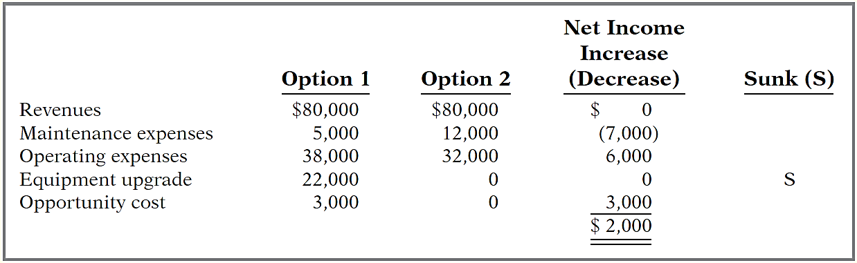
The company currently follows Option 1, with revenues of $80,000 per year, maintenance expenses of $5,000 per year, and operating expenses of $38,000 per year. Option 2 provides revenues of $80,000 per year, maintenance expenses of $12,000 per year, and operating expenses of $32,000 per year. Option 1 employs a piece of equipment that was upgraded 2 years ago at a cost of $22,000. If Option 2 is chosen, it will free up resources that will increase revenues by $3,000.

Slide 11
Learning Objective 20-2
Special Orders

Slide 12
Outline
Accept an order at a special price

Slide 13
Accept a Special Order
Obtain additional business by accepting a special order.
Assumes that sales of products in other markets are not affected by special order.
Assumes that company is not operating at full capacity.

Slide 14
Accept a Special Order
Illustration: Sunbelt Company produces 100,000 Smoothie blenders per month, which is 80% of plant capacity. The following table shows basic information of the blenders.
Sunbelt has an offer from Kensington Co. (a foreign wholesaler) to purchase an additional 2,000 blenders at $11 per unit. Acceptance of the offer would not affect normal sales of the product, and the additional units can be manufactured without increasing plant capacity. What should management do?
Variable manufacturing costs per unit | $8
Fixed manufacturing costs | $400,000
Selling price per unit | $20

Slide 15
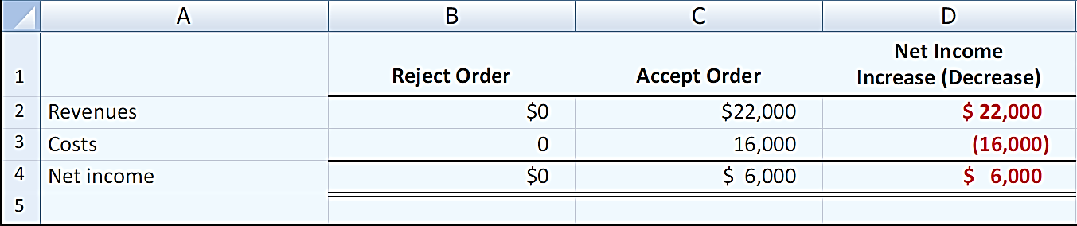
Accept a Special Order
Variable manufacturing costs per unit | $8
Fixed manufacturing costs | $400,000
Selling price per unit | $20
Units sold | 100,000
New offer | 2,000 blenders at $11 per unit
Fixed costs do not change since within existing capacity – thus fixed costs are not relevant.
Variable manufacturing costs and expected revenues change – thus both are relevant to the decision.

Slide 16
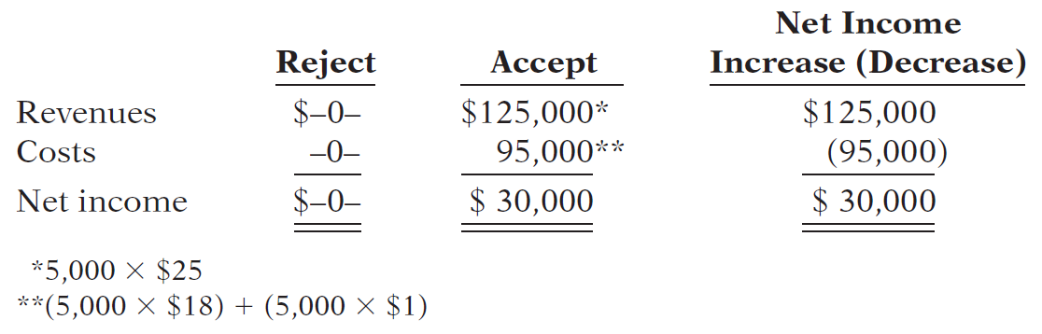
Special Orders
Cobb Company incurs costs of $28 per unit ($18 variable and $10 fixed) to make a product that normally sells for $42. A foreign wholesaler offers to buy 5,000 units at $25 each. Cobb will incur additional shipping costs of $1 per unit. Compute the increase or decrease in net income Cobb will realize by accepting the special order, assuming Cobb has excess operating capacity. Should Cobb Company accept the special order?
Accept or Reject?
Accept or Reject?

Slide 17
Learning Objective 20-3
Make or Buy

Slide 18
Outline
The make or buy decision
Make or buy decision with opportunity costs

Slide 19
Make or Buy Decision
Manufacturing companies must decide whether to make or buy components when producing a finished product.
The decision to buy parts of services is often referred to as outsourcing.

Slide 20
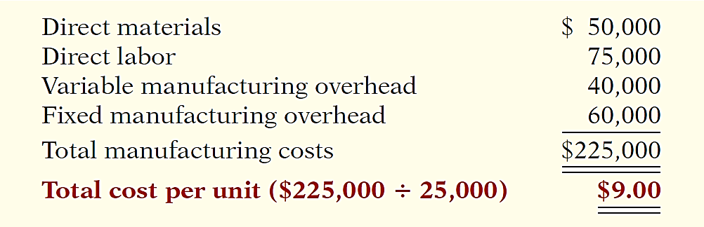
Make or Buy Decision
Illustration: Baron Company incurs the following annual costs in producing 25,000 ignition switches for motor scooters.
Instead of making its own switches, Baron Company might purchase the ignition switches at a price of $8 per unit. If purchasing the ignition switches, only $10,000 of its fixed manufacturing costs can be avoided. What should management do?

Slide 21
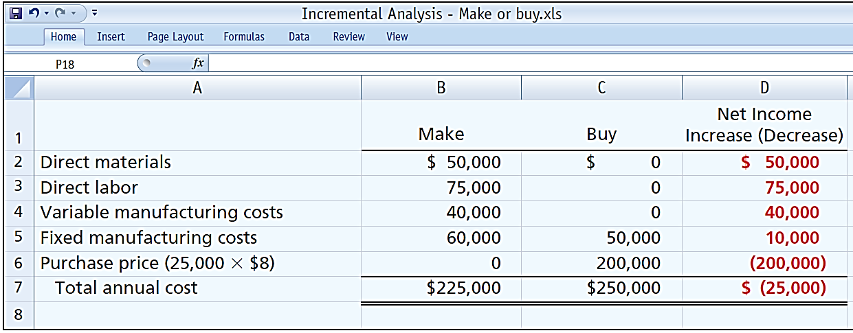
Make or Buy Decision
Total manufacturing cost is $1 higher per unit than purchase price.
Must absorb at least $50,000 of fixed costs under either option.

Slide 22
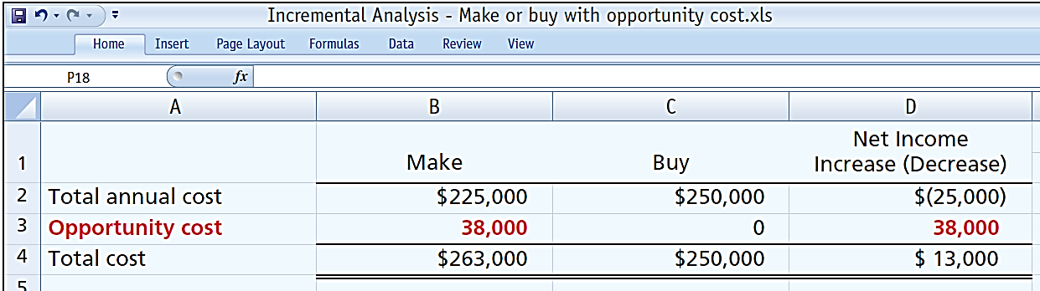
Make or Buy Decision with Opportunity Costs
Illustration: Assume that through buying the switches, Baron Company can use the released productive capacity to generate additional income of $38,000 from producing a different product.

Slide 23
Make or Buy Decision
Question
In a make-or-buy decision, relevant costs are:
a. Manufacturing costs that will be saved.
b. The purchase price of the units.
c. Opportunity costs.
d. All of the above.

Slide 24
Learning Objective 20-4
Sell or Process Further

Slide 25
Outline
Sell or process further
Single-product case
Multiple-product case

Slide 26
Sell or Process Further
May have option to sell product at a given point in production or to process further and sell at a higher price.
Decision rule – process further as long as the incremental revenue from such processing exceeds the incremental processing costs.

Slide 27
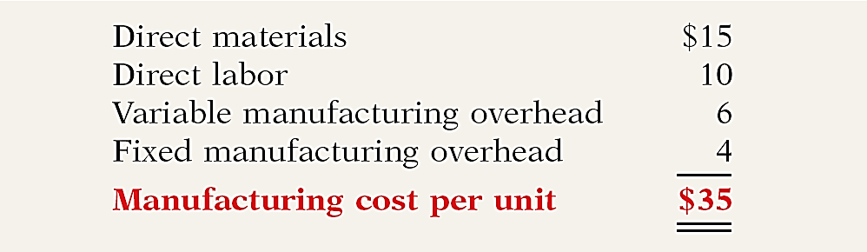
Single-Product Case
Illustration: Woodmasters Inc. makes tables. The cost to manufacture an unfinished table is $35. The selling price per unfinished unit is $50. Woodmasters has unused capacity that can be used to finish the tables and sell them at $60 per unit. For a finished table, direct materials will increase $2 and direct labor costs will increase $4. Variable manufacturing overhead costs will increase by $2.40 (60% of direct labor). No increase is anticipated in fixed manufacturing overhead.

Slide 28
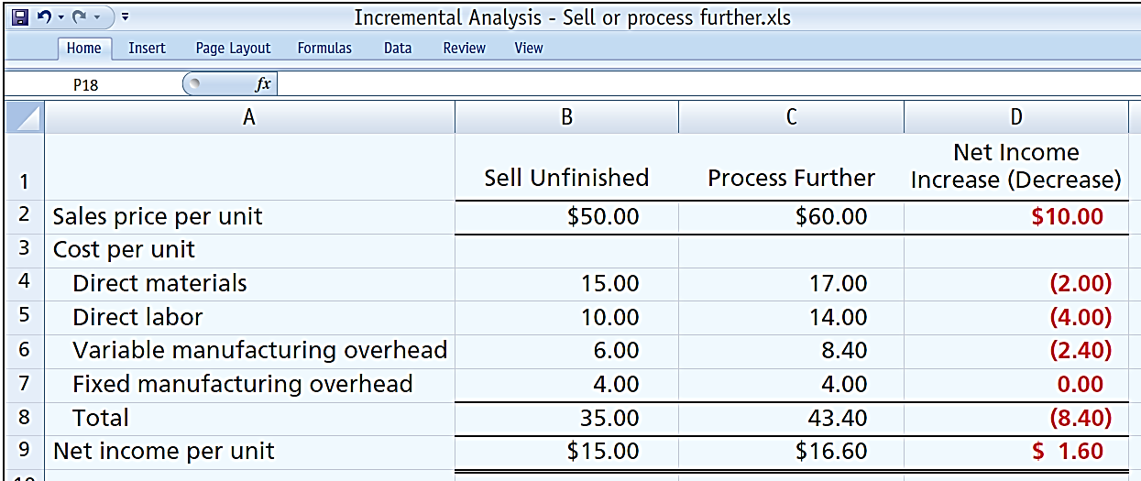
Single-Product Case
The incremental analysis on a per unit basis is as follows.
Should Woodmasters sell or process further.
Should Woodmasters sell or process further?

Slide 29
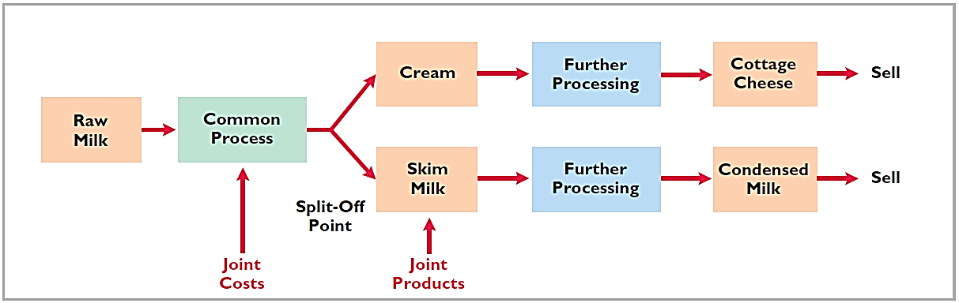
Multiple-Product Case
Joint product situation for Marais Creamery. Cream and skim milk are products that result from the processing of raw milk.
Joint product costs are costs incurred prior to the point at which the two products are separately identifiable (split-off point)
Joint product costs are sunk costs and thus not relevant to the sell-or-process further decision.

Slide 30
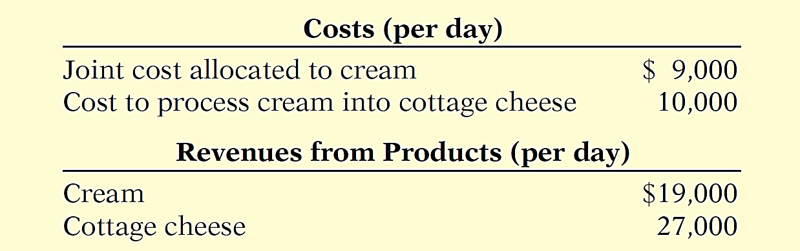
Multiple-Product Case
Cost and revenue data per day for cream.
Sunk cost
Determine whether the company should simply sell the cream or process it further into cottage cheese.

Slide 31
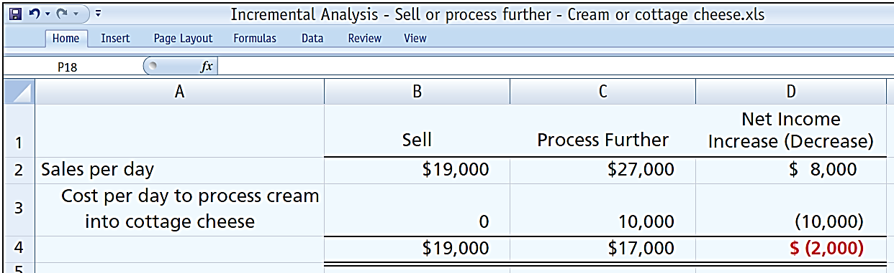
Multiple-Product Case
Analysis of whether to sell cream or process into cottage cheese.
Marais should not process the cream further.
Marais should or should not process the cream further?

Slide 32
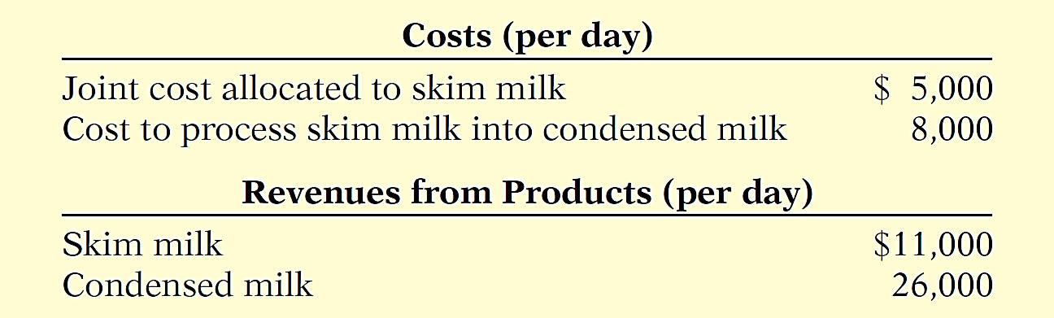
Multiple-Product Case
Cost and revenue data per day for skim milk.
Sunk cost
Determine whether the company should sell the skim milk or process it further into condensed milk.

Slide 33
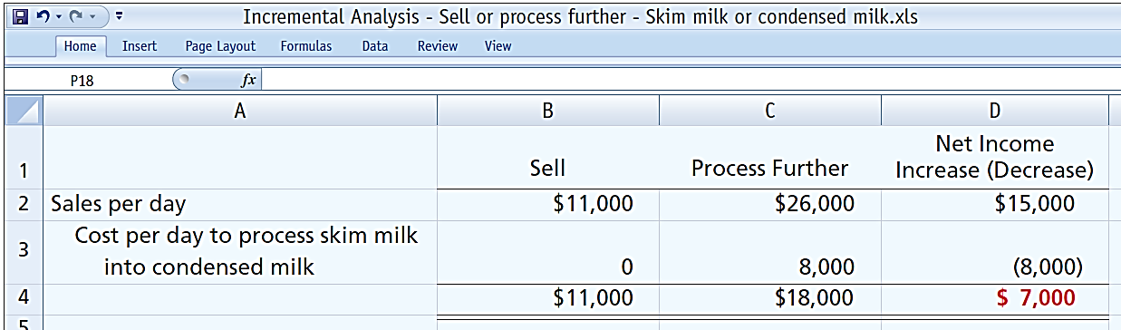
Multiple-Product Case
Analysis of whether to sell skim milk or process into condensed milk.
Marais should process the milk further.
Marais should or should not process the milk further?

Slide 34
Sell or Process Further
Question
The decision rule is a sell-or-process-further decision:
Process further as long as the incremental revenue from processing exceeds:
a. Incremental processing costs.
b. Variable processing costs.
c. Fixed processing costs.
d. No correct answer is given.

Slide 35
Learning Objective 20-6
Eliminate Unprofitable Segment Or Product

Slide 36
Outline
Eliminate an unprofitable segment or product

Slide 37
Eliminate an Unprofitable Segment or Product
Key: focus on relevant costs.
Consider effect on related product lines.
Fixed costs allocated to the unprofitable segment must be absorbed by the other segments.
Net income may decrease when an unprofitable segment is eliminated.
Decision rule: retain the segment unless fixed costs eliminated exceed contribution margin lost.

Slide 38
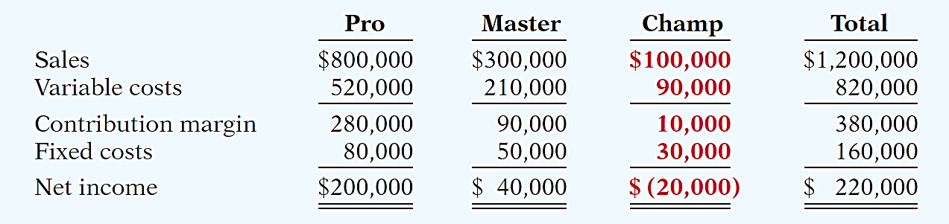
Eliminate an Unprofitable Segment or Product
Illustration: Venus Company manufactures three models of tennis rackets:
Profitable lines: Pro and Master
Unprofitable line: Champ
Should Champ be eliminated?

Slide 39
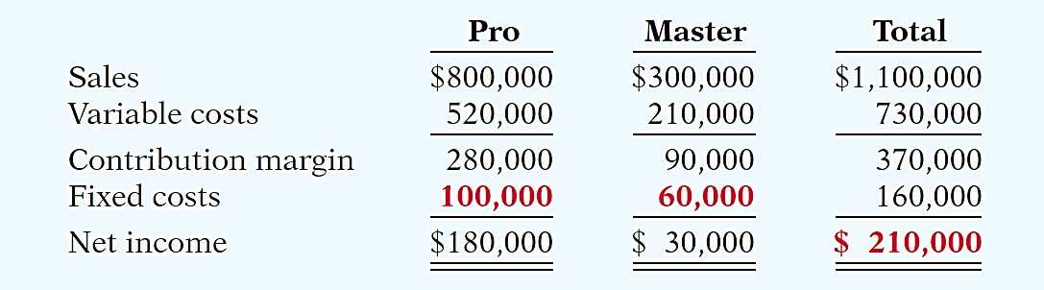
Eliminate an Unprofitable Segment or Product
Prepare income data after eliminating Champ product line. Assume fixed costs are allocated 2/3 to Pro and 1/3 to Master.
Total income changed by -$10,000.

Slide 40
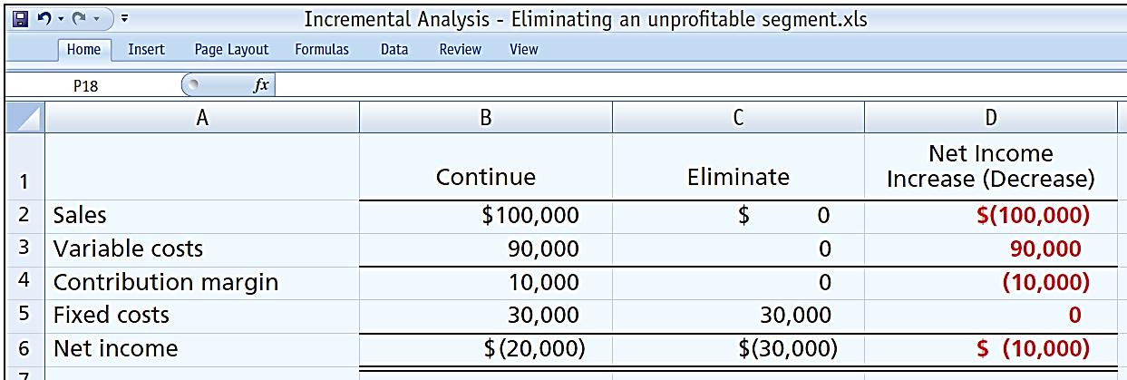
Eliminate an Unprofitable Segment or Product
Incremental analysis of Champ provided the same results:
Do Not Eliminate Champ

Slide 41
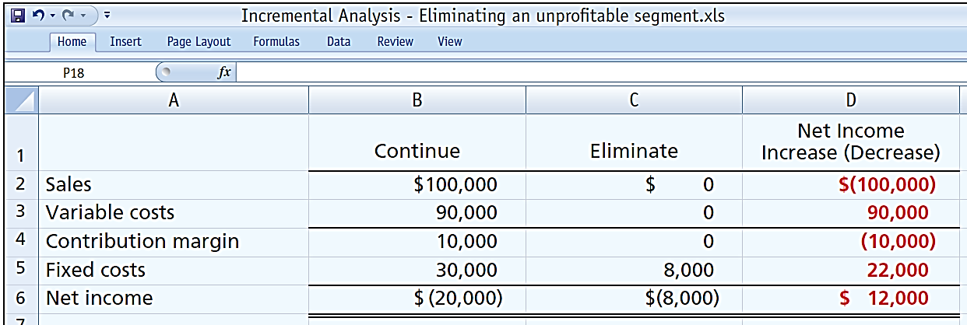
Eliminate an Unprofitable Segment or Product
Assume that $22,000 of the fixed costs attributed to the Champ line can be eliminated if the line is discontinued.
Eliminate Champ

Slide 42
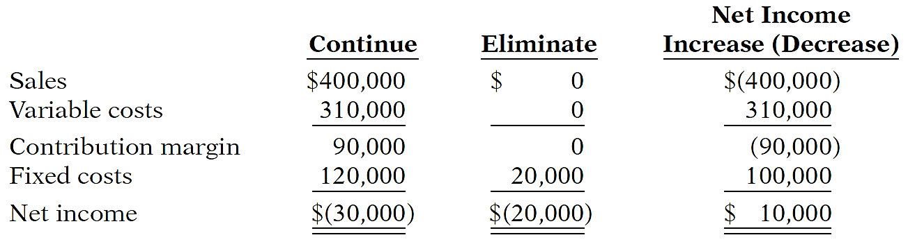
Unprofitable Segments
Lambert, Inc. manufactures several types of accessories. For the year, the knit hats and scarves line had sales of $400,000, variable expenses of $310,000, and fixed expenses of $120,000. Therefore, the knit hats and scarves line had a net loss of $30,000. If Lambert eliminates the knit hats and scarves line, $20,000 of fixed costs will remain. Prepare an analysis showing whether the company should eliminate the knit hats and scarves line.

Slide 43
Incremental Analysis
Question
If an unprofitable segment is eliminated:
a. Net income will always increase.
b. Variable expenses of the eliminated segment will have to be absorbed by other segments.
c. Fixed expenses allocated to the eliminated segment will have to be absorbed by other segments.
d. Net income will always decrease.

Slide 44
Learning Objective 21-1
Target costing

Slide 45
Outline
Pricing factors
Pricing good for external sales
Target costing

Slide 46
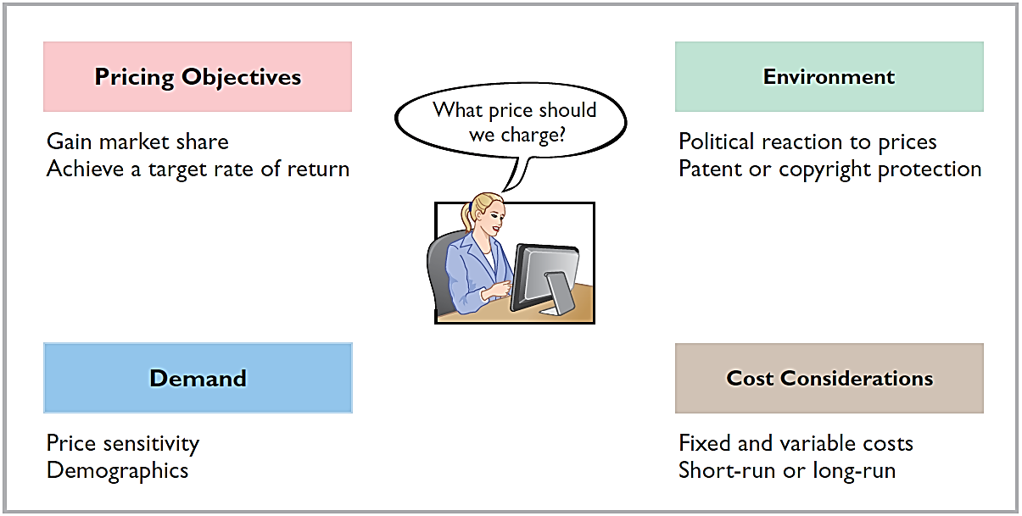
Pricing Factors
The price of a good or service is affected by many factors.
Regardless of the factors involved, the price must cover the costs of the good or service as well as earn a reasonable profit.

Slide 47
Pricing Goods for External Sales
The price of a good or service is affected by many factors.
Company must have a good understanding of market forces.
Where products are not easily differentiated from competitor goods, prices are not set by the company, but rather by the laws of supply and demand – such companies are called price takers.
Where products are unique or clearly distinguishable from competitor goods, prices are set by the company – such companies are call price makers.

Slide 48
Target Costing
In a competitive market, the price is set by the market.
To earn a profit, companies must focus on controlling costs.
Requires setting a target cost that will provide the company’s desired profit.
Target cost: cost that provides the desired profit when the market determines a product’s price.
If a company can produce its product for the target cost or less, it will meet its profit goal.

Slide 49
Target Costing
First – identify its market niche where it wants to compete.
Second – determine the price the company believes will place it in the optimal position for the target consumers)
Third – determine its target cost by setting a desired profit.
Last – assemble a team to develop a product to meet the company’s goals (e.g. features and costs).

Slide 50
Target Costing
Fine Line Phones is considering introducing a fashion cover for its phones. Market research indicates that 200,000 units can be sold if the price is no more than $20. If Fine Line decides to produce the covers, it will need to invest $1,000,000 in new production equipment. Fine Line requires a minimum rate of return of 25% on all investments. Determine the target cost per unit for the cover.
The desired profit for this new product line is
$1,000,000 x 25% = $250,000
Each cover must result in profit of $250,000 ÷ 200,000 units = $1.25
Market price Desired profit Target cost per unit
$20 $1.25 $18.75 per unit
-
=

Slide 51
Target Costing
Question
Target cost related to price and profit means that:
a. Cost and desired profit must be determined before selling price.
b. Cost and selling price must be determined before desired profit.
c. Price and desired profit must be determined before costs.
d. Costs can be achieved only if the company is at full capacity.

Slide 52
Learning Objective 21-2
Cost-plus and Variable-cost Pricing

Slide 53
Outline
Cost-plus pricing
Dollar markup per unit
Markup percentage
Limitations of cost-plus pricing

Slide 54
Cost-Plus Pricing
In an environment with little or no competition, a company may have to set its own price (i.e. price maker)
When a company sets price, the price is normally a function of product cost: cost-plus pricing.
Approach requires establishing a cost base and adding a markup to determine a target selling price.
Desired profit

Slide 55
Cost-Plus Pricing
In determining the proper markup, a company must consider competitive and market conditions.
Size of the markup (the “plus”) depends on the desired return on investment for the product:
ROI = net income / invested assets

Slide 56
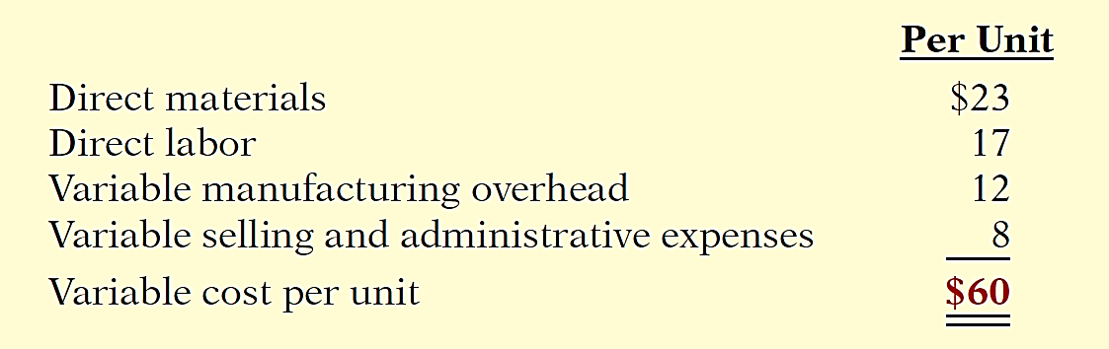
Cost-Plus Pricing
Illustration: Thinkmore Products, Inc. is in the process of setting a selling price on its new video camera pen. It is a functioning pen that will record up to 2 hours of audio and video. The per unit variable cost estimates for the new video camera pen are as follows.

Slide 57
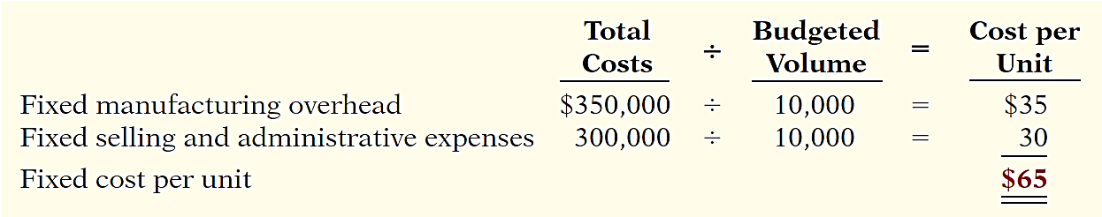
Cost-Plus Pricing
In addition, Thinkmore has the following fixed costs per unit at a budgeted sales volume of 10,000 units.

Slide 58
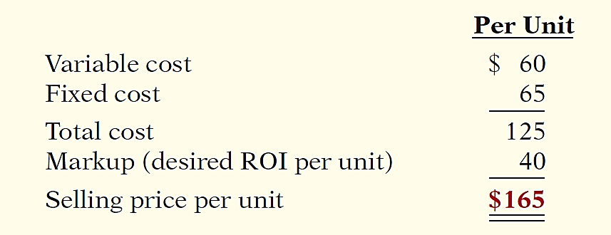
Dollar Markup per Unit
Thinkmore has decided to price its new video camera pen to earn a 20% return on its investment (ROI) of $2,000,000.
Desired ROI = 20% ROI of $2,000,000 = $400,000
Markup = $400,000 ÷ 10,000 units = $40

Slide 59
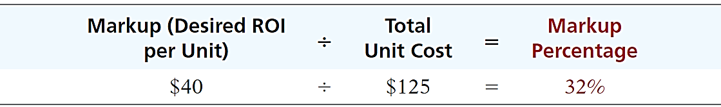
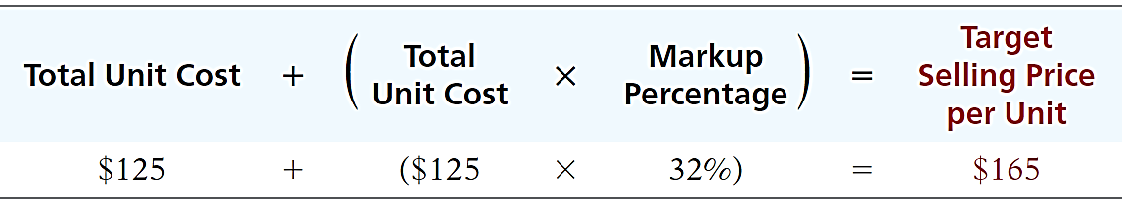
Markup Percentage
Use markup on cost to set a selling price:
Compute the markup percentage to achieve a desired ROI of $40 per unit:
Compute the target selling price:

Slide 60
Limitations of Cost-Plus Pricing
Advantage: Easy to compute.
Disadvantages:
Does not consider demand side:
Will the customer pay the price?
Fixed cost per unit changes with change in sales volume:
At lower sales volume, company must charge higher price to meet desired ROI.
The desired ROI will only be achieved when the company sells the quantity budgeted.

Slide 61
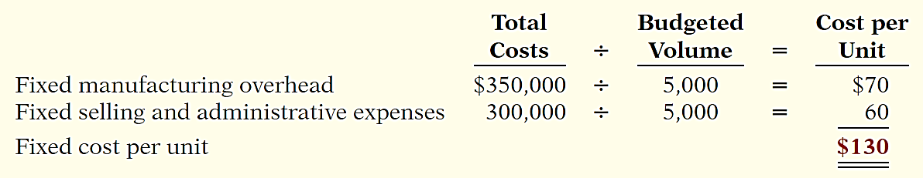
Limitations of Cost-Plus Pricing
Illustration: If budgeted sales volume for Thinkmore’s Products was 5,000 instead of 10,000, Thinkmore’s variable cost per unit would remain the same. However, the fixed cost per unit would change as follows.
Thinkmore's desired 20% ROI now results in a $80 ROI per unit [(20% x $2,000,000) / 5,000].

Slide 62
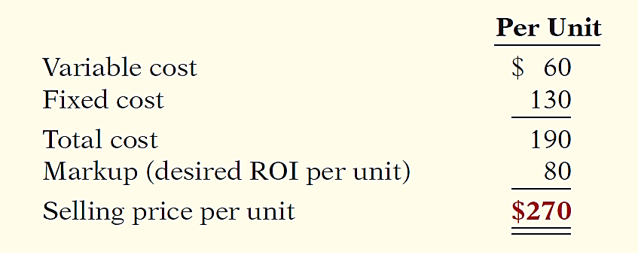
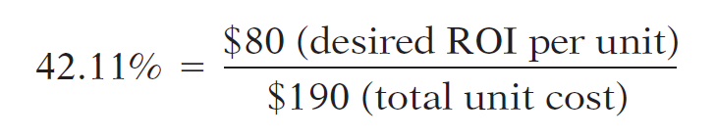
Limitations of Cost-Plus Pricing
Thinkmore computes the selling price at 5,000 units as follows.
Higher
At 5,000 units, how much would Thinkmore mark up its total unit costs to earn a desired ROI of $80 per unit.

Slide 63
Variable-Cost Pricing
Alternative pricing approach:
Simply add a markup to variable costs.
Avoids the problem of uncertain cost information related to fixed-cost-per-unit computations.
Helpful in pricing special orders or when excess capacity exists.
Major disadvantage is that managers may set the price too low and fail to cover fixed costs.

Slide 64
Cost-Plus Pricing
Question
Cost-plus pricing means that:
a. Selling price = variable cost + (markup % + variable cost).
b. Selling price = cost + (markup % x cost).
c. Selling price = manufacturing cost + (markup % + manufacturing cost).
d. Selling price = fixed cost + (markup % x fixed cost).

